Slide 1


Effects of Sub-Atmospheric Pressures on the Temperature Evolution of Spark Kernels
Daniel Caplan and David Blunck, PhD.
Oregon State University
SciTech, 8-12 January 2018
Kissimmee, Florida

Slide 2

Introduction
Studying how subatmos pressure affects
the temperature
Fluid mechanics
Other characteristics
Intro | Background | Experiment | Image Processing | Results | Conclusions

Slide 3
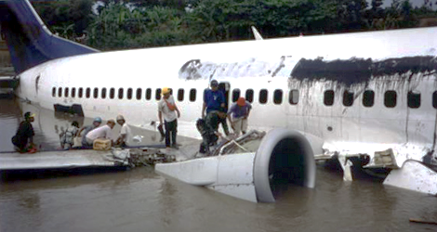
Why study low pressure ignition?
Midflight flameout
Push the ignition altitude envelope?
Afterburner ignition
High altitude ignition, right now!
http://www.aviation-accidents.net/garuda-indonesia-boeing-b737-300-pk-gwa-flight-ga421/
Intro | Background | Experiment | Image Processing | Results | Conclusions

Slide 4
How is ignition studied?
Minimum Ignition Energy (MIE)
Spark Kernels
Reacting
Non-Reacting
Mathematical Modeling
Intro | Background | Experiment | Image Processing | Results | Conclusions

Slide 5
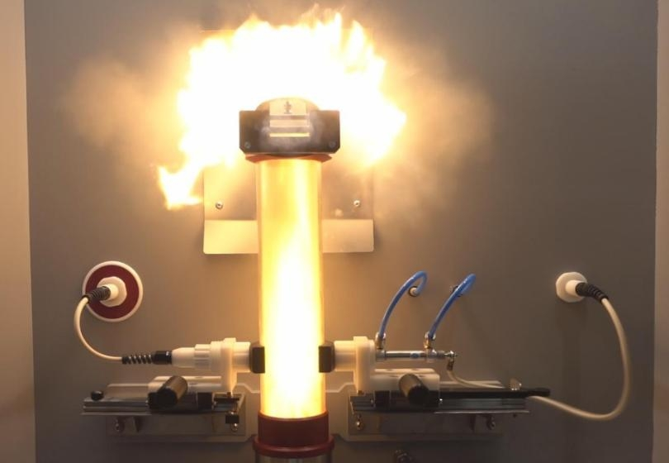
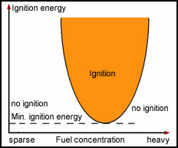
How is ignition studied?
Minimum Ignition Energy (MIE)
Intro | Background | Experiment | Image Processing | Results | Conclusions

Slide 6
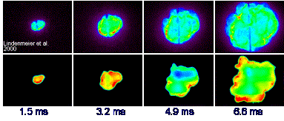
How is ignition studied?
Spark Kernels: Reacting
Upper: Chemiluminescence
Lower: OH* Laser Induced Fluorescence (LIF)
http://www.itt.kit.edu/english/323.php
Intro | Background | Experiment | Image Processing | Results | Conclusions

Slide 7
How is ignition studied?
Spark Kernels: Non-Reacting
Schlieren image of kernels from Sforzo
Plot: Kernel temperatures from literature
Intro | Background | Experiment | Image Processing | Results | Conclusions

Slide 8
How is ignition studied?
Spark Kernels: Mathematical Modeling
Model image of kernels from Sforzo
Intro | Background | Experiment | Image Processing | Results | Conclusions

Slide 9
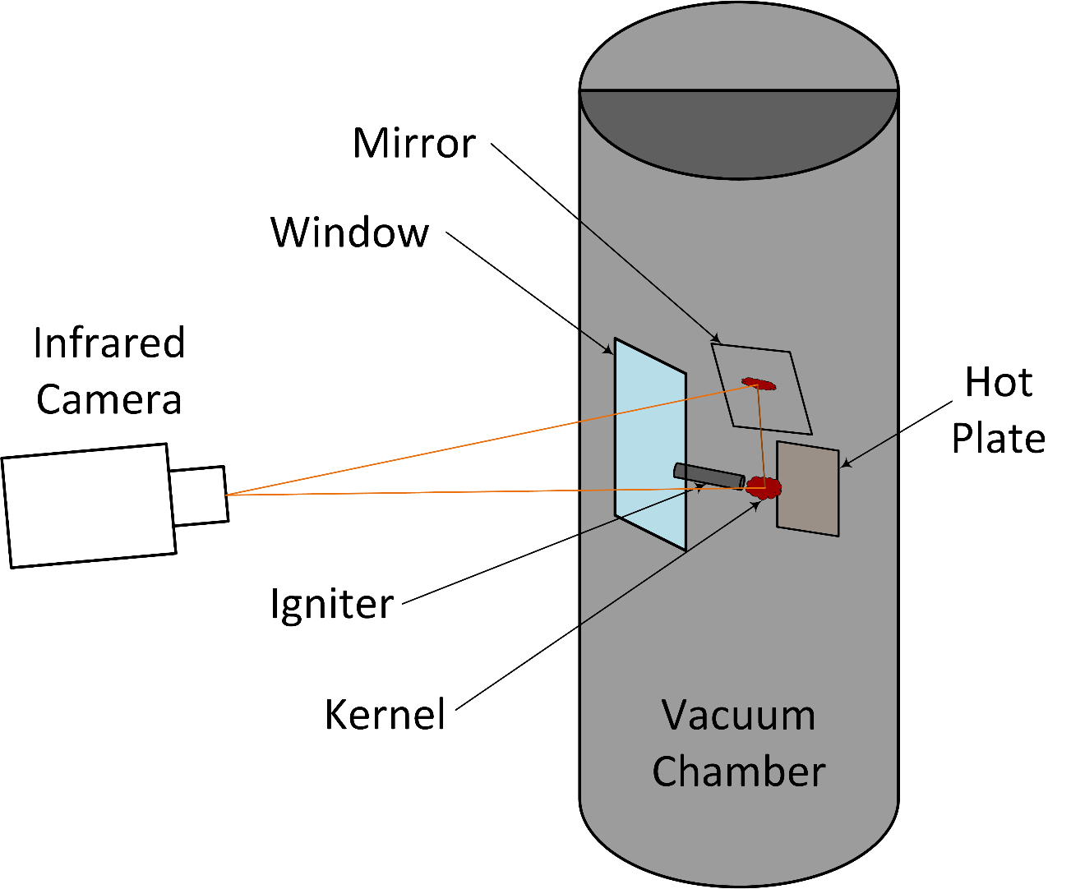
Experimental Setup
Intro | Background | Experiment | Image Processing | Results | Conclusions

Slide 10
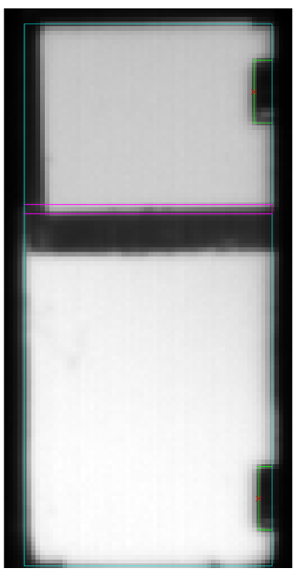
Field of View
Photo of chamber with igniter inside
Intro | Background | Experiment | Image Processing | Results | Conclusions

Slide 11
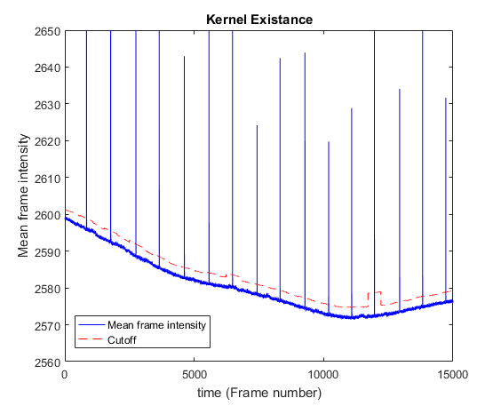
Finding the kernels in the data
Intro | Background | Experiment | Image Processing | Results | Conclusions

Slide 12
Determining Path Length
Intensity image with side view
Edge Detected Kernel
Ellipse axes
Intro | Background | Experiment | Image Processing | Results | Conclusions

Slide 13
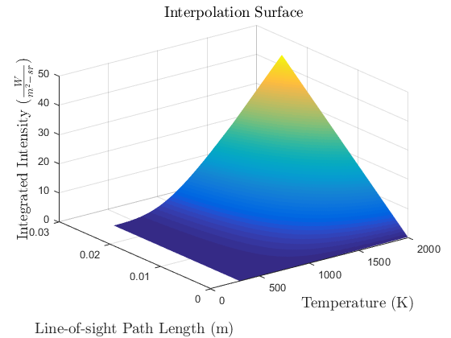
Temperature interpolation surface
Intro | Background | Experiment | Image Processing | Results | Conclusions

Slide 14

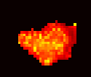
Determined Temperature
Intensity image…
Temperature imge…
Intro | Background | Experiment | Image Processing | Results | Conclusions

Slide 15
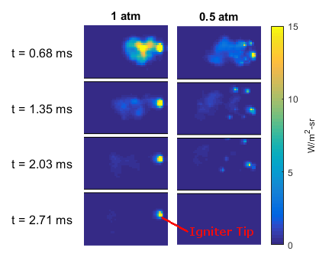
Kernel Intensities
1.0 atm video
0.6 atm video
0.3 atm video
At lower pressure,
lower radiation emissions
shorter detectable duration
splits up more
more material ablation
Intro | Background | Experiment | Image Processing | Results | Conclusions

Slide 16
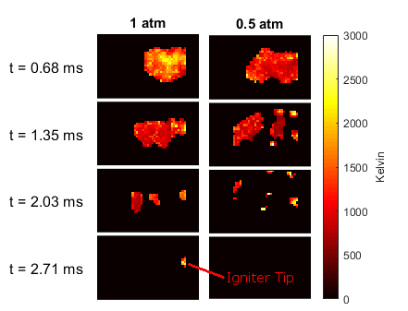
Kernel Temperatures
1.0 atm video
0.6 atm video
0.3 atm video
At lower pressure,
Lower temperature?
splits up more
more material ablation
Intro | Background | Experiment | Image Processing | Results | Conclusions

Slide 17
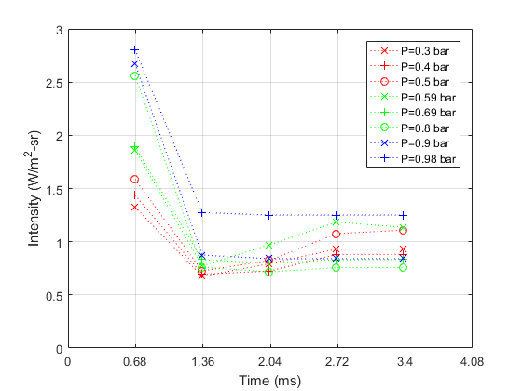
Average Intensity Emissions
Intro | Background | Experiment | Image Processing | Results | Conclusions

Slide 18
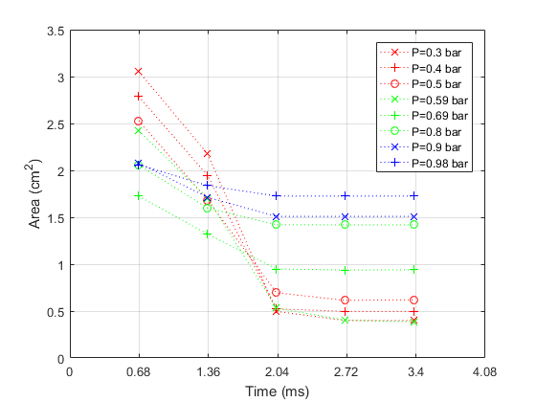
Apparent area
Intro | Background | Experiment | Image Processing | Results | Conclusions

Slide 19
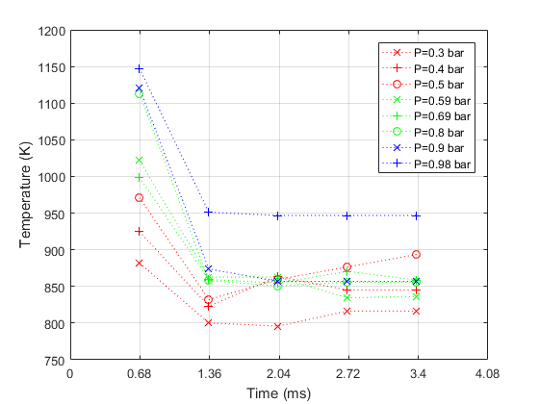
Average Kernel Temperatures
Intro | Background | Experiment | Image Processing | Results | Conclusions

Slide 20
Takeaways
At lower pressure…
Lower radiation emissions
Lower temperatures
More material ablation
Intro | Background | Experiment | Image Processing | Results | Conclusions

Slide 21



Slide 22
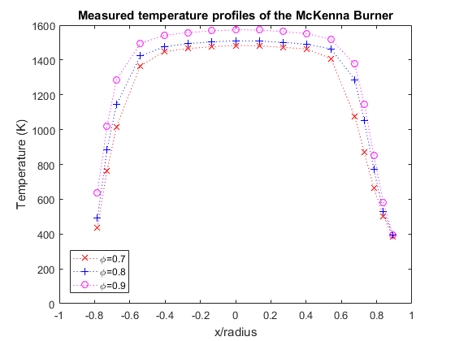
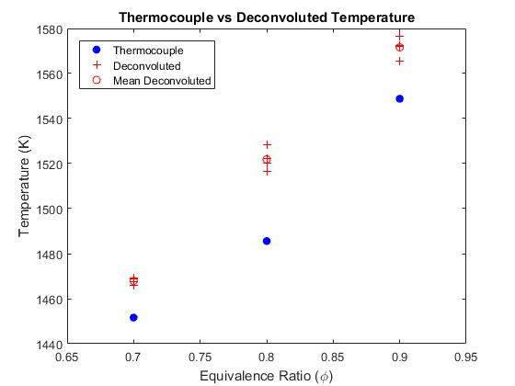
Technique Evaluation

Slide 23
Presentation Title
Template is optional. Please note formatting guidelines below.
Landscape orientation
4:3 Ratio
Font
Sans serif (e.g. Arial, Tahoma)
Sized 24-40 points
Minimal information—highlight main points
No commercialism/advertising
Can your slides be easily read from 15 meters away?

